Slide 1

INST737
INTRODUCTION TO DATA SCIENCE
MILESTONE-2
Team-5 Presentation
Sadaf Nasir Davre
Tanya Gupta
Ushasri Bhogaraju

Slide 2

Post Milestone 1 enhancements
A quick summary of the work done before starting on milestone 2
Additional Data Collection:
Sourced supplementary datasets to enhance analysis depth.
Provisioned labels for clearer data interpretation.
Data Preparation:
Merged and harmonized datasets for a holistic view.
Standardized data formats and units for consistency.
Data Cleaning:
Identified and addressed new missing values and outliers.
Re-validated data types to ensure no duplicates.
Enhanced outlier detection methods post feedback.
Notes:
Well done! Thank you.

Slide 3
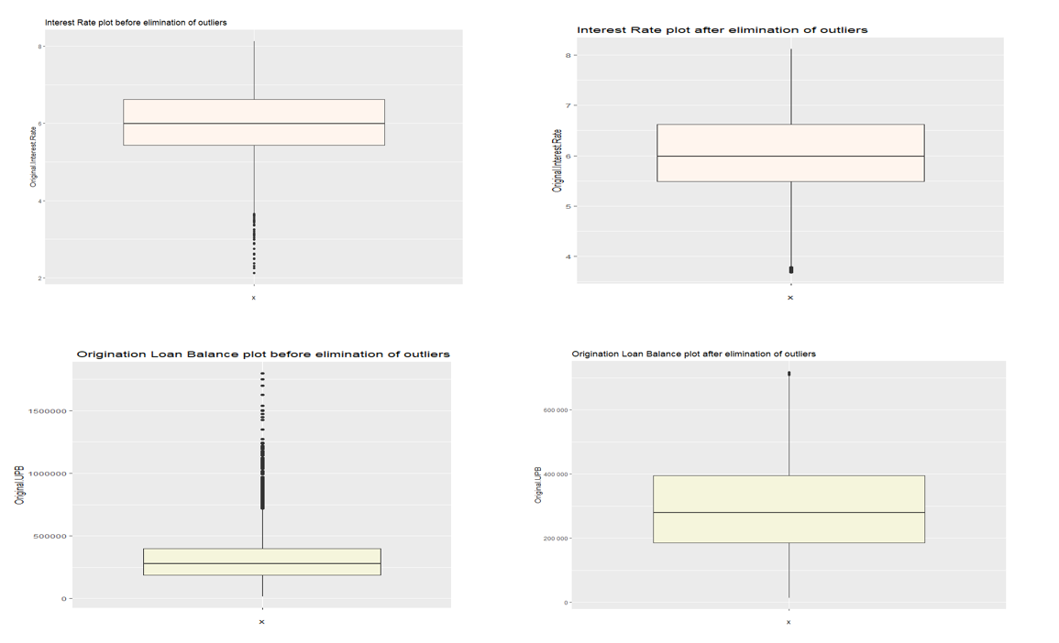
Milestone 2, phase 1a : Linear regression
Dataset Cleaning & Outlier Removal: Used histograms, summary statistics, and BoxPlots to detect outliers. Implemented the IQR method for outlier removal. The dataset had various types of variables like numerical, categorical, and nominal. After outlier removal, a cleaned dataset named "Cleaned_FM2022Q4.csv" with 248,356 observations of 13 variables was obtained.
Residual Analysis: Residuals (differences between actual and predicted values) were analyzed to check for normal distribution. Approximate Gaussian distributions were observed for residuals.
Training & Test Data Splitting: The dataset was split into training (75%) + test (25%) datasets using R to ensure random selection.
Linear Regression Analysis: Linear models were computed between each independent variable (IV) and the dependent variable (DV). Each IV's relationship with the DV was analyzed, with interpretations about the intercept, coefficient, and whether it's a predictive feature. Notable variables with predictive power included Original UPB, Borrower Credit Score at at Origination, and Seller Name with slightly better predictive power for “interest rate”.
Notes:
Well done

Slide 4
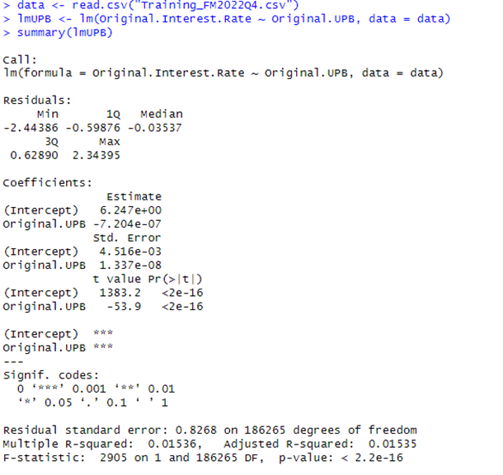
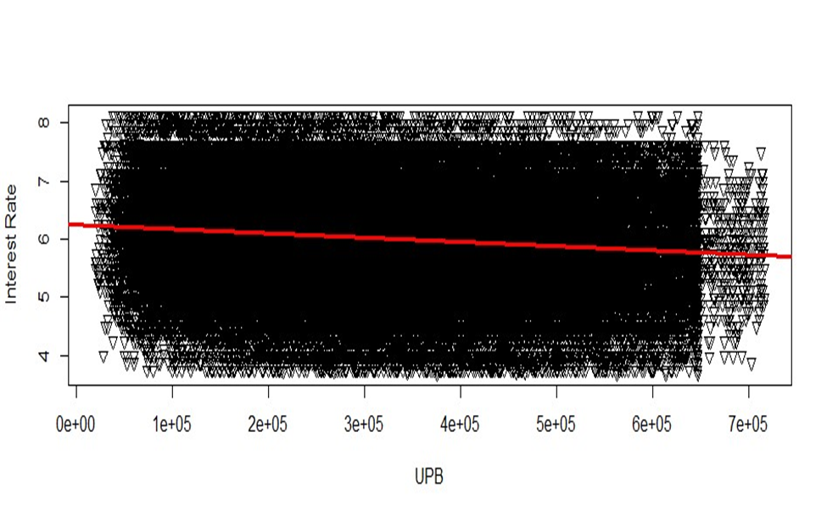
Linear regression between ‘Original UPB’ and ‘ Original interest rate’
Summary : The negative coefficient and the highly significant t-value suggest that there is a statistically significant negative relationship between the Original.UPB predictor variable and the Original.Interest.Rate outcome variable. However, the magnitude of the coefficient is extremely small, indicating that while there is a statistically significant relationship, the practical impact on one-unit change in Original.UPB on Original.Interest.Rate is minimal.
Notes:
Answer all these questions from the report here: What is the intercept? : The questions from the report would be answered while the speaker is presenting.
- What is the coefficient?
- Is it a predictive feature?
- Which are the most predictive features according to the training data?
- What are the residuals? Is a linear regression applicable to your problem?

Slide 5
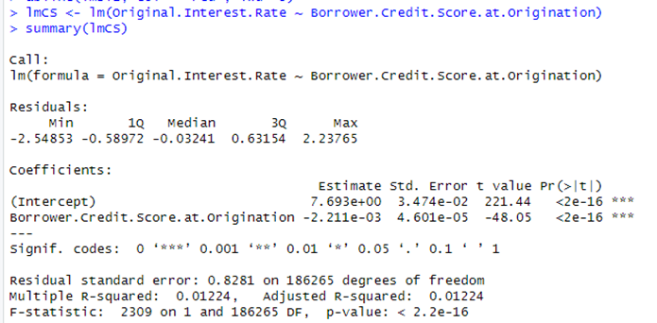
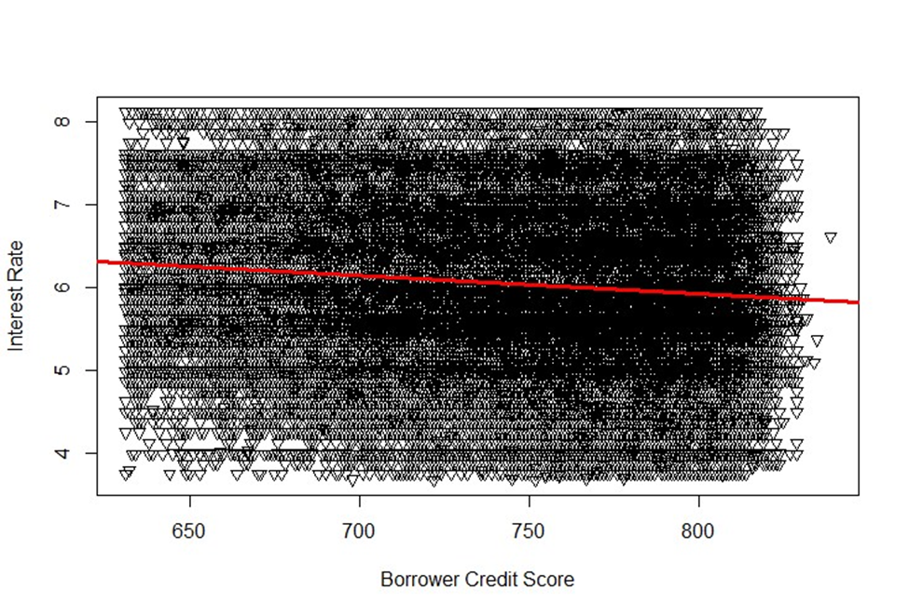
Linear regression between ‘Borrower Credit Score’ and ‘ Original interest rate’
Summary : The Borrower Credit Score's negative coefficient, combined with its highly significant p-value, indicates a statistically significant inverse relationship with the dependent variable. However, the magnitude of this coefficient is minimal, suggesting that while the relationship is statistically important, the practical impact of a unit change in Borrower Credit Score on the Interest Rate is negligible.
Notes:
Answer all these questions from the report here: What is the intercept? Since we are using Borrower credit score as the linear model to check with prediction bands in the next slide, added this graph here.
- What is the coefficient?
- Is it a predictive feature?
- Which are the most predictive features according to the training data?
- What are the residuals? Is a linear regression applicable to your problem?

Slide 6
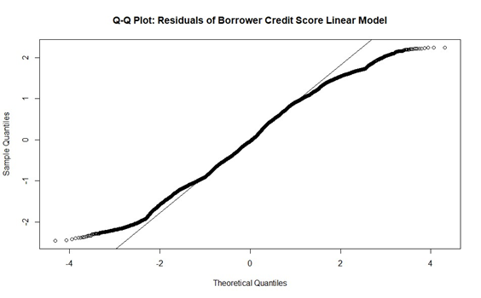
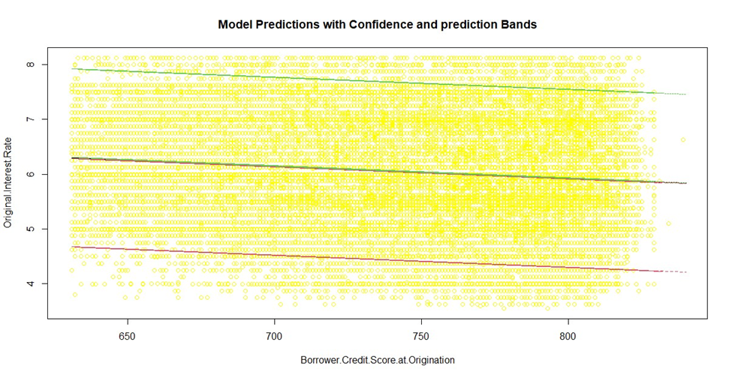
Is a linear regression applicable to our problem?
Model Applicability: The residuals' distributions suggested linear regression might not be the best choice, but it provided insights into each variable's predictive power. Variables with no predictive power might be excluded in future analyses. Predictive Accuracy on Test Data: The trained model was used to predict on test data. The correlation between predicted and actual values was found to be 0.1090926, indicating a weak relationship. The mean squared error (MSE) was 0.6834206, showing relatively small squared errors. Confidence and prediction bands were also plotted to visualize where the prediction values lie.
Notes:
Data changed during code run. Images are fine. I changed the interpretation to match with the report

Slide 7
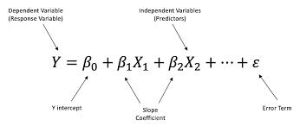
1.b: Multivariate regressions
Key observations: Some combinations improved coefficients and R-squared values. Certain models exhibited only minor improvements.
Model 1: UPB + Credit Score
Slight improvement in R-squared; not close to 1.
Significance exists but with small coefficients.
Model 2: Seller Name + Occupancy Status
Improved R-squared but with very small coefficients.
Model 3: Seller Name + Property Type
R-squared same as individual Seller Name model.
Model 4: UPB+Credit Score+ Seller Name + Occupancy Status
Better R-squared than individual models but with smaller coefficients.
Model 5: bondRate + fedFundsRate+ Borrower Credit Score + UPB+ Seller Name : Best R-squared among all models but still not close to 1.
Key takeaway: Independent variables show statistical significance but low predictive power. Decision: Considered additional IVs for a more meaningful analysis.
Notes:
Please give the combination of the best model… you can leave out others if required

Slide 8
Research Questions Addressed
1.)Variables Used: Research question variables, Seller Name, Occupancy Status, Property State, and Property Type. Model Metrics: Small coefficients and low R-squared values. Predictive Power: Models have limited accuracy in predicting 'Interest Rate'. Conclusion: Fannie Mae dataset insufficient for answering the research question.
1.Can we accurately predict the ‘Interest Rate’ applied to a mortgage loan by a lending institution, using criterion such as the Quantum of loan, Loan-To-Value ratio, Debt-To-Income ratio, Loan Purpose, Number of Borrowers and Credit Score of the Borrower/s, using the Fannie Mae Acquisition and Performance 2022Q4 dataset?
2.Do all the borrower criteria such as the Quantum of loan, Loan-To-Value ratio, Debt-To-Income ratio, Loan Purpose, Number of Borrowers and Credit Score of the Borrower/s have equal influence over ‘Interest Rate’? If not, which criteria have more effect on Interest Rate?
3.(Revised) Can we accurately predict the class of Occupancy Status in the Loan dataset, based on the IVs, Original interest rate, bondRate, fedFundsRate, Borrower Credit Score and Original UPB (from the revised dataset)?
2.)Quantum of Loan & Credit Score: Statistically significant inverse effect; however, mild due to small coefficients and R-squared values.Other Variables: Minimal and varied positive impact on 'Original Interest Rate'. Seller Name Impact: Coefficients range from 0.23 to 1.15 (statistically significant) but with a low R-squared of 0.11.
Conclusion: Current variables lack predictive power on Original interest rate. Next Steps: Introduce new variables from other datasets to improve model accuracy.
3.)Previous Objective: Assess impact of 'Seller Name' on 'Interest Rate'. Linear Model Result: Insignificant predictive power with R-squared of 0.11. Conclusion: Cannot determine answer with existing dataset; aspect excluded from primary research. Reframed Research Question. New Focus: Predict class of 'Occupancy Status' in Loan dataset.Key IVs for Prediction: Original interest rate, bondRate, fedFundsRate, Borrower Credit Score, and Original UPB (from revised dataset).
Notes:
Please change the details in this slide according to the changes in research question in the report : changed question, addressed the new question in the following slides.

Slide 9
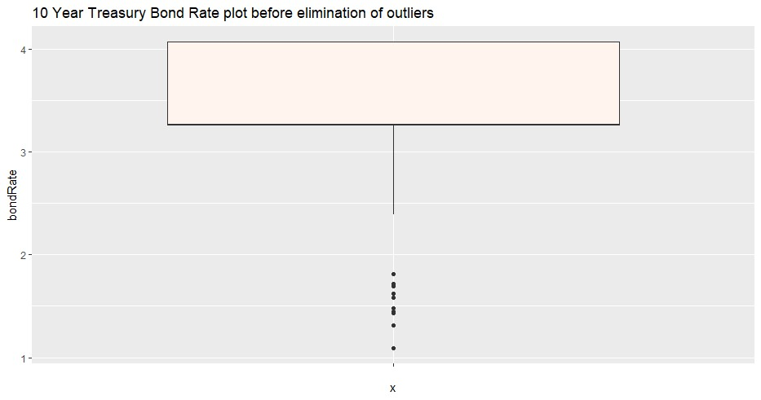
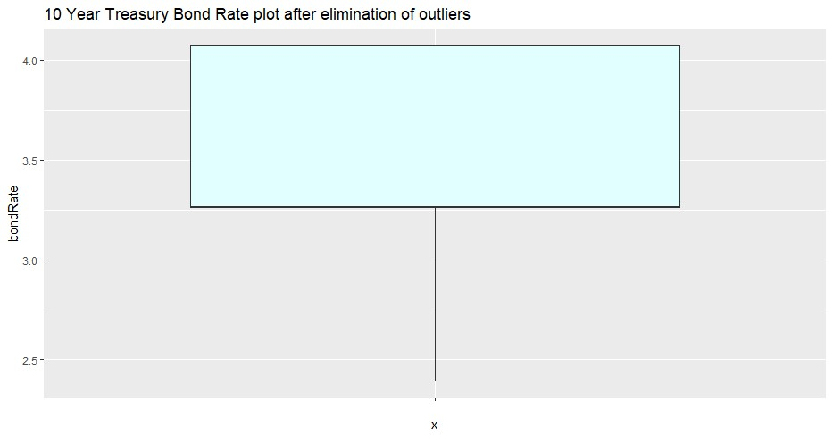
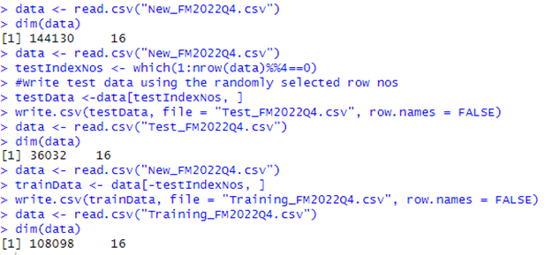
New Enhancements, New Dimensions
Infused new variables: 'bondRate', 'fedFundsRate', and 'benchMarkMortgageRate'.
Data sources: macrotrends.net (10-year Treasury Bond rates, 30-year benchmark mortgage interest rates)
Matched variables based on 'date' column.
Started with 271,368 observations and 16 variables.
Outlier removal and other transformations reduced it to 144,130 observations.
Dataset split: "Test_FM2022Q4.csv" and "Training_FM2022Q4.csv"

Slide 10
Predictive Power of New Variables
BondRate, fedFundsRate, and benchMarkMortgageRate exhibited better coefficients and R-squared values.
New variables led to better model predictions.
Validating Models with New Variables:
Validated models using distributions of residuals.
Residuals followed a near-normal distribution.

Slide 11
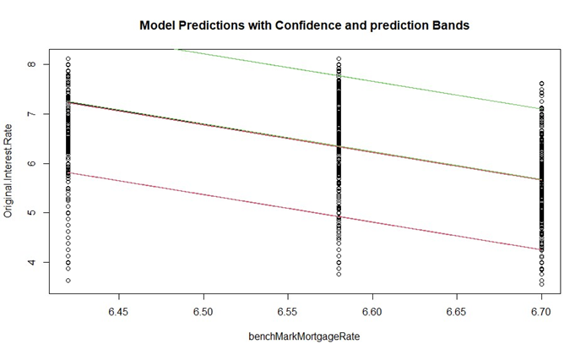
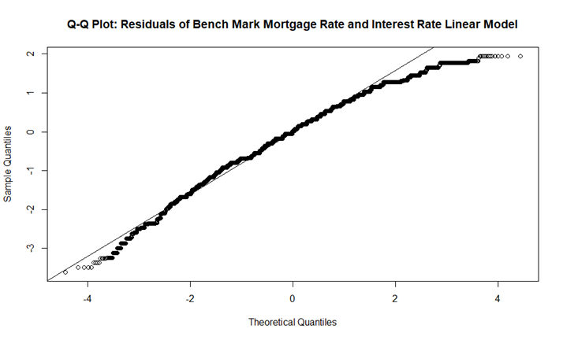
Multivariate Regression Analysis Summary
Models with new variables showed superior predictive power.
Linear models with bondRate, fedFundsRate, and benchMarkMortgageRate outperformed others.
Reporting Prediction Accuracy:Used correlation and mean squared error (MSE) for accuracy.
Models incorporating new variables demonstrated better correlation and lower MSE values.
Issues with Current Variables:
Problematic Variables: "benchMarkMortgageRate", “Loan Purpose”, and “Number of Units. ”. Issue: Exhibit multicollinearity; perfect correlation with variables like fedFundsRate. Solution: Identified w/ Pearson’s correlation; removed from dataset for improved training.
While some models showed improvements, others exhibited minor or no change.
Multivariate regressions with new variables offered better predictive accuracy.
Notes:
Added Issues with current variables here please add the block type you did for other boxes….

Slide 12
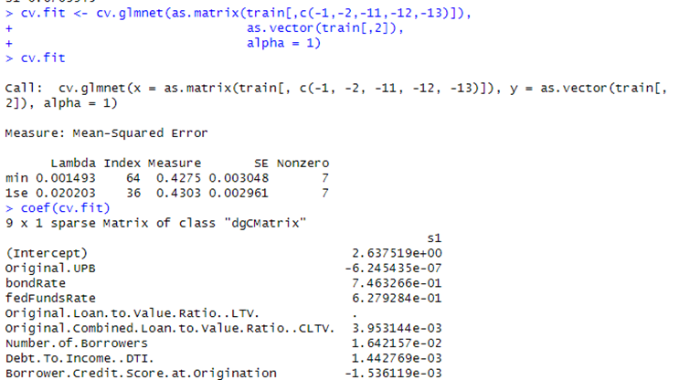
1.c Regularization
Objective: Improve model by eliminating some variables.
Need: Too many features leading to poor predictions.
Benefits: Prevents overfitting and improves model generalization.
Methods: Used Lasso regularization with alpha =1
Notes:
Changed the image to the model. And notes also.

Slide 13
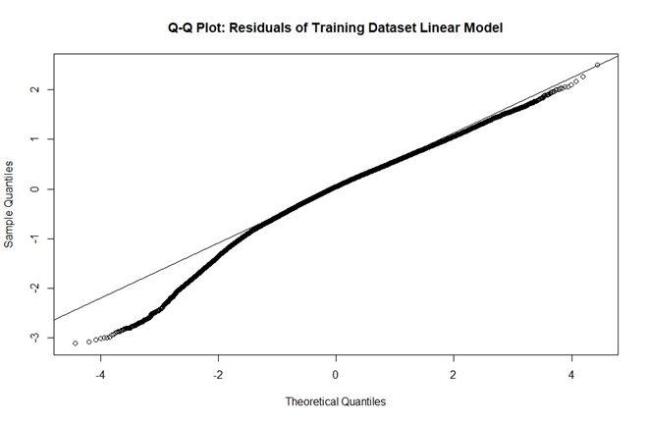
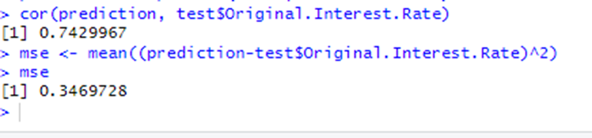
Regularization Process:
Preparation: Removed non-numeric columns like ‘Seller Name’, “Property Type”, etc.
Method: Used “glmnet” function in R.
Visualization: Plotted log(lambda) values and MSE for understanding ineffective variables.
Residuals and Model Performance:
Residuals: Don't follow Gaussian distribution.
Correlation: r = 0.7429967 between predicted and actual outcomes.
MSE: 0.3469728.

Slide 14
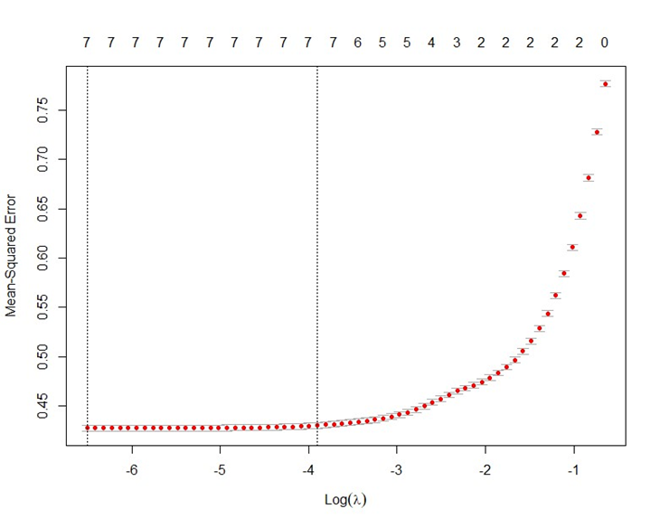
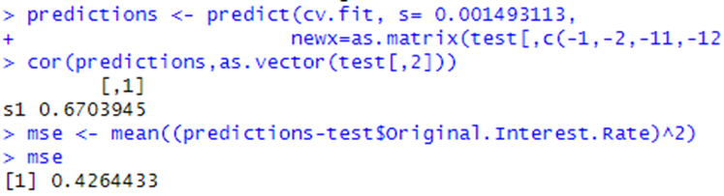
Regularization Results and Interpretation
Optimal Lambda: 0.001493 via cv.glmnet function.
Key Coefficients: 'bondRate' = 0.7463266, 'fedFundsRate' = 0.6279284.
Findings: LTV variable has no effect; model not better than non-regularized one.
Comparison: MSE = 0.4264433, higher than non-regularized model.
Notes:
Good

Slide 15
1.d Comparative Analysis of Model Performance Across Varied Training and Testing Sets
Objective of the Analysis:
Reveal answers to research questions through Milestone-2.
Analyze effects of using different training and testing sets on linear Regression, multivariate regression, and regularization.
Investigate differences in coefficients, R-squared values, correlation, and MSE values across different dataset runs.
Approach and Methodology
Summarized results from previous linear and multivariate analyses.
Identified variables exhibiting multicollinearity.
Created multiple randomized training and test datasets.
Replicated results from predictive models.
Analyzed and summarized results.

Slide 16
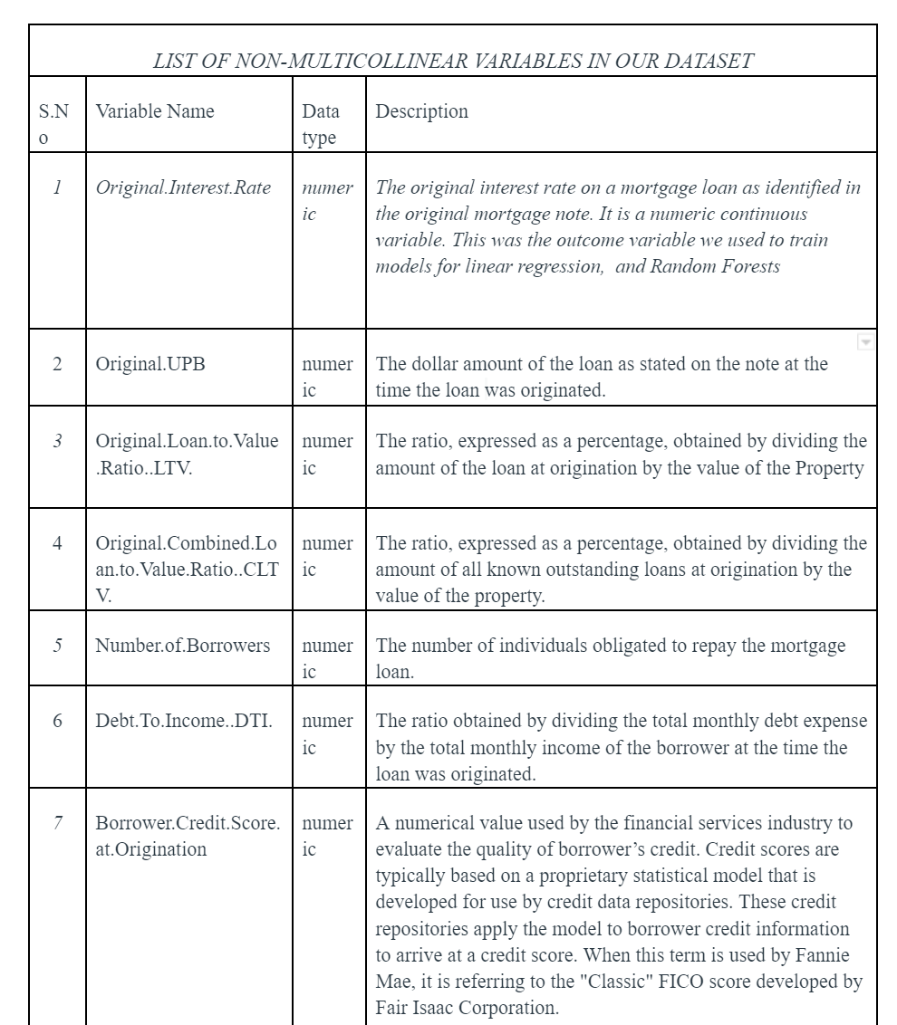
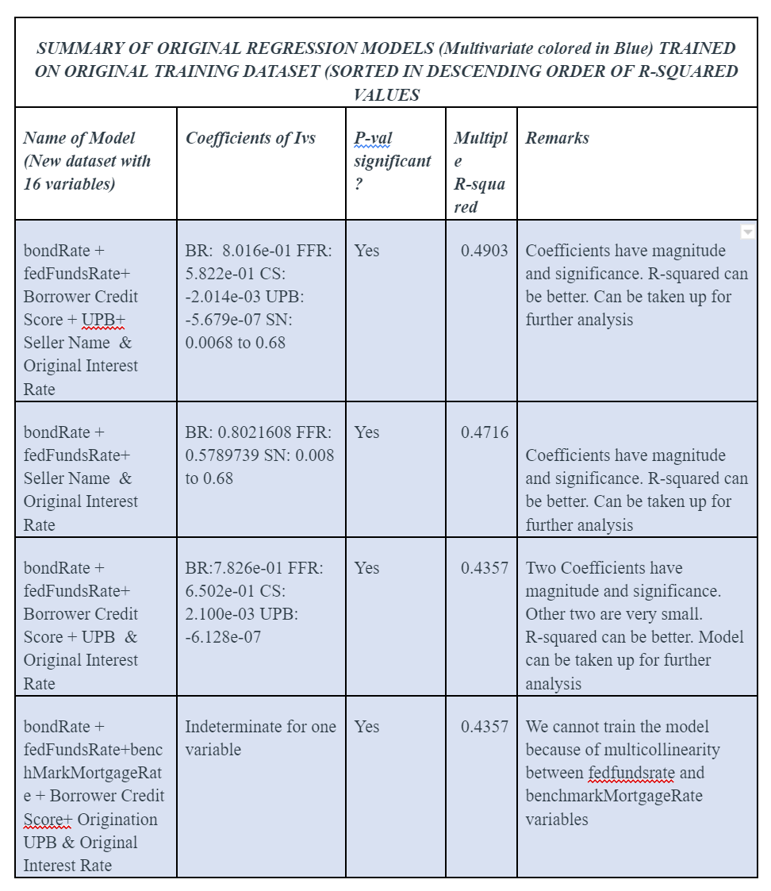
Original Regression Model Summary
Displayed table with columns: Name of Model, Coefficients of IVs, P-value significance, Multiple R-squared, and Remarks.
Highlighted models sorted by descending order of R-squared values.

Slide 17
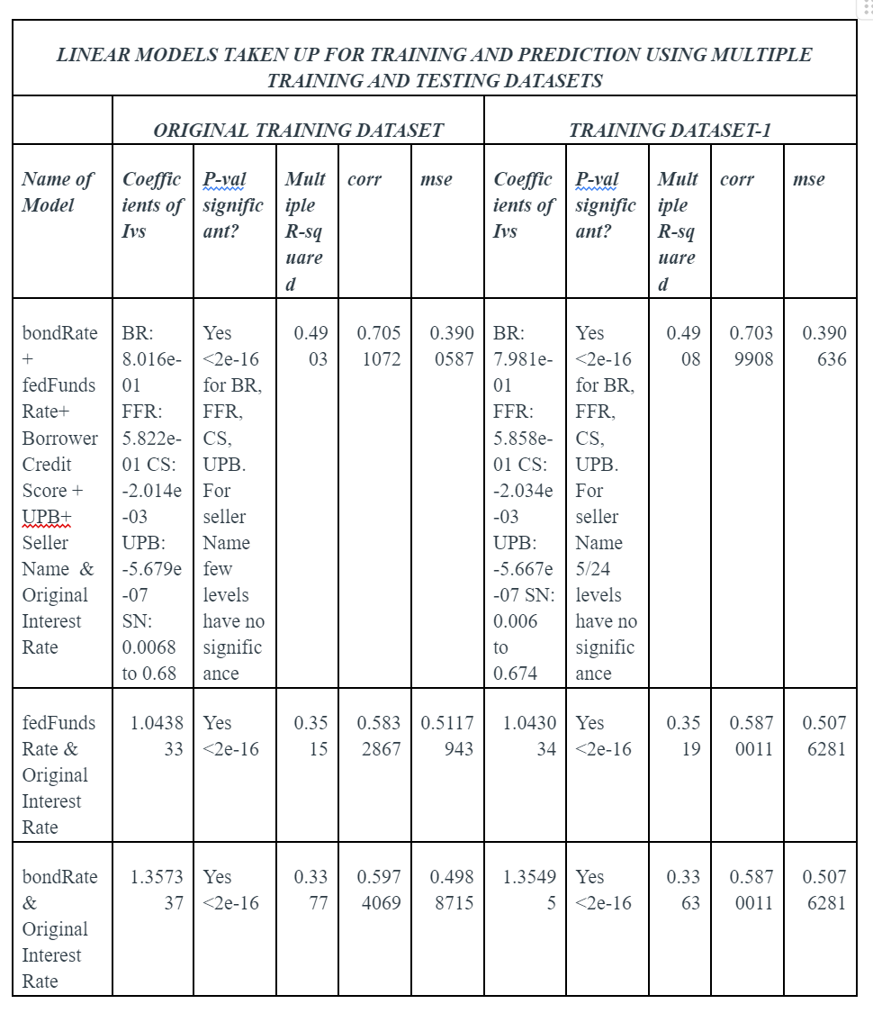
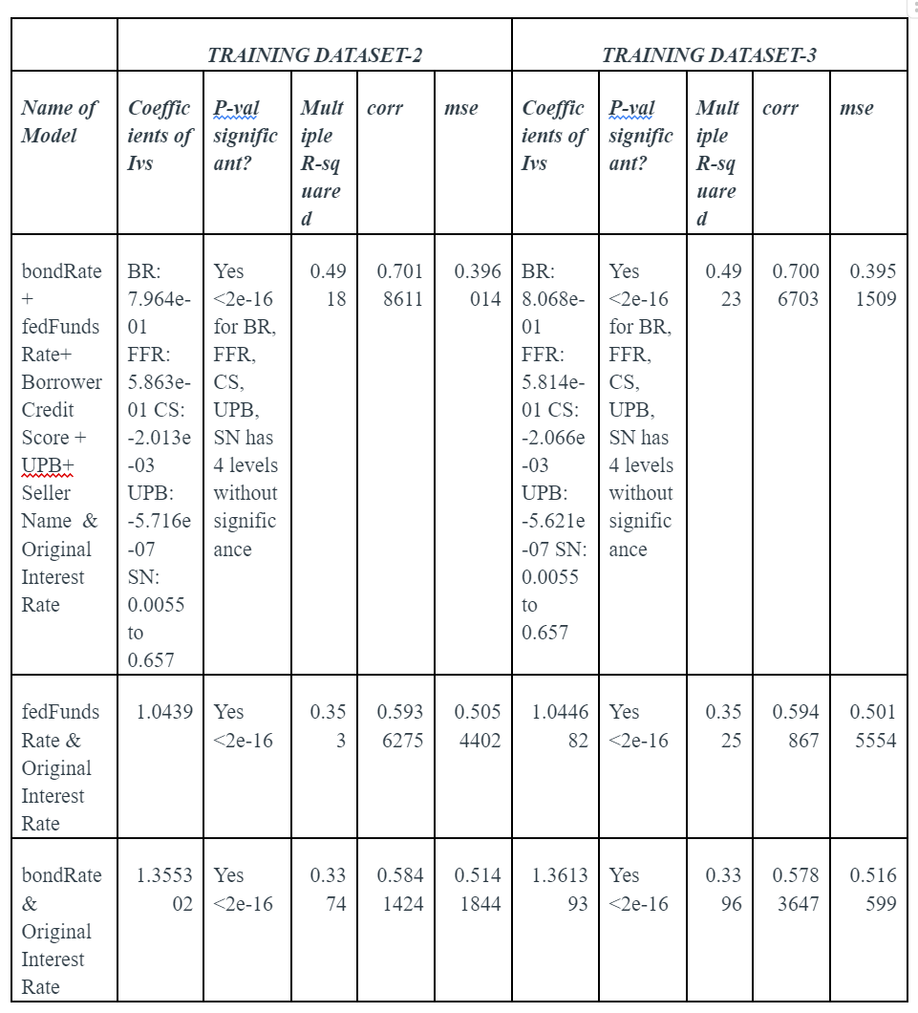
Non-Multicollinear Variables in Dataset: List of non-multicollinear variables used to create Training and Test sets.
Display table with columns: S.No, Variable Name, Data type, and Description.
Model Training and Prediction:
Compared models across various training datasets.
Display table with columns: Name of Model, Coefficients of IVs for each training dataset, P-value significance, Multiple R-squared, Correlation, and MSE.
Interpretation of Model Results:
Striking similarities observed across dataset runs.
No significant differences in coefficients, their significance, R-squared values, or prediction metrics.
Original analysis findings remain valid.

Slide 18
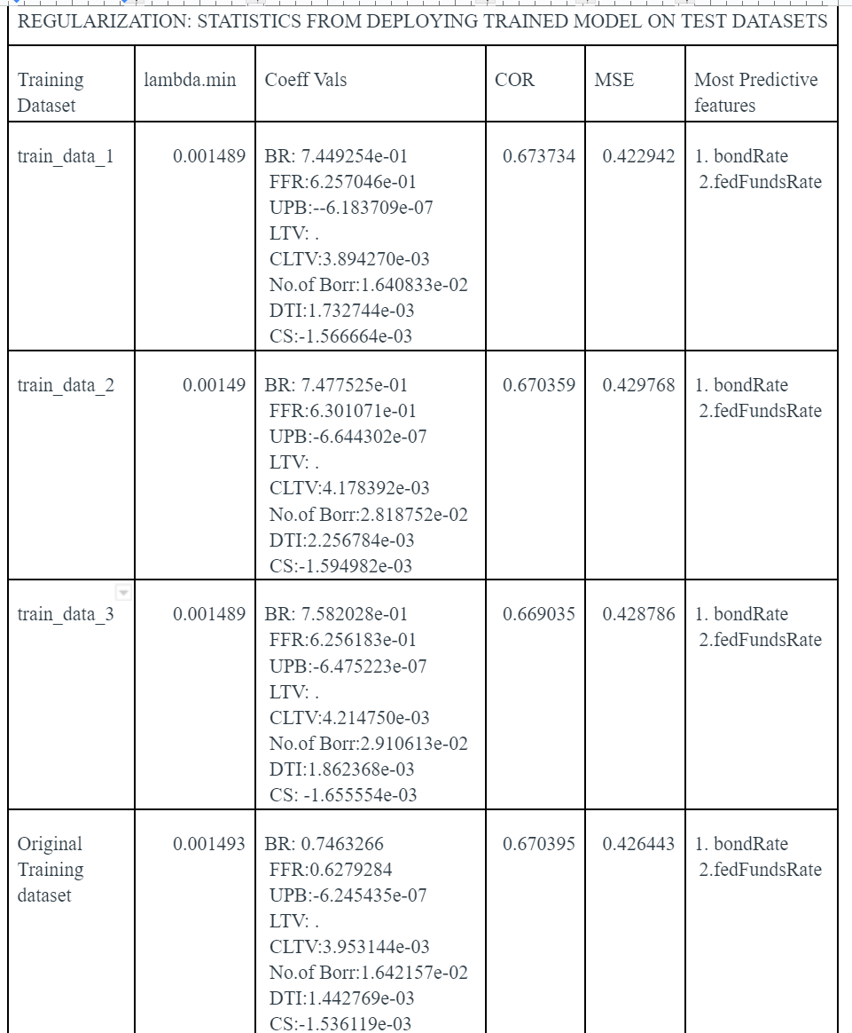
Regularization - Overview and interpretation of results
Reporting results from regularization on multiple datasets.
Display table with columns: Training Dataset, lambda.min, Coeff Vals, COR, MSE, and Most Predictive features.
Coefficient values from original trained dataset compared to multiple datasets.
The lambda.min values, correlation, and MSE values from test dataset predictions are consistent.
Results from regularization with multiple datasets align with original values.
Robustness of the model tested across multiple datasets.
Consistency observed in results regardless of dataset used.
The findings provide confidence in the model's reliability.

Slide 19
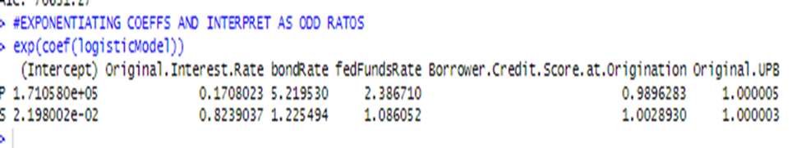
Phase 2a :Logistic Regression
Model Workings Primarily used for binary classification.Uses the sigmoid function to model the probability of a binary outcome. The function squashes any input z into a value between o and 1.
The output of the model is the probability of the input belonging to one of the two classes. We used multinomial model because our output variable has three classes.
Objective: Explore "Occupancy Status" as DV with classes "P", "I", and "S" to answer our third research question. Multinomial logistic regression models were used to classify the outcome into more than two classes.
Chosen Variables for Logistic Regression Run1
IVs: Original Interest Rate, bondRate, fedFundsRate, Borrower Credit Score, Original UPB.
DV: Occupancy Status with classes: "P", "I", and "S".
Run2: 15 IVs
Log-odds The natural algorithm of the odds of the probability of the IV belonging to a class other than reference category
Odd-ratios: For one unit increase in the IV, the odds of it being in one class versus reference category

Slide 20
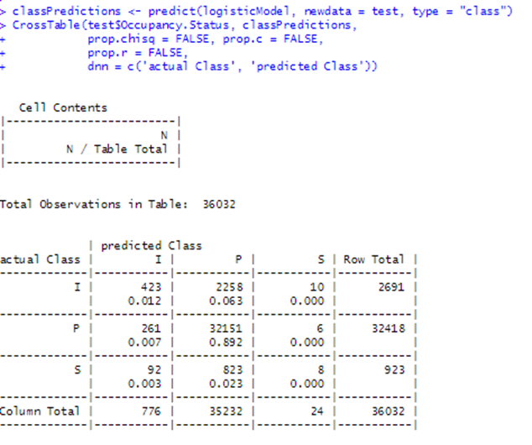
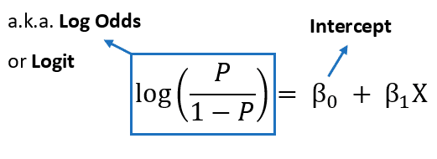
Logistic Regression Results
Most predictive features: Most levels of Seller Name variable, followed by Original Interest Rate, Bond Rate, and Federal Funds Rate.
Model excels in predicting class "P" but underperforms for "I" and "S"
Confusion Matrix or the Cross Table show the performance of the model. The True Positives are 423 for I class, , 3215 for P class, and only 8 for S class.
Reason for underperformance could be that the model is more suitable for binary classification

Slide 21
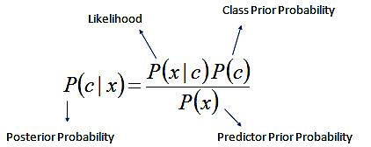
2.b Naïve Bayes analysis
Classifier based on Bayes theorem. Suitable for text analysis.
Model workings : Calculates conditional probabilities for the predictive features and predicts outcome variable.
Run-1 and Run-2 with same set of variables as used for Logistic regression.
Reason for Comparison: Analyze performance differences between the two classifiers.
If the dataset is sparse, Laplace smoothing helps in ensuring no undue weights are attached to the less occurring events. Which is not the case in our dataset

Slide 22
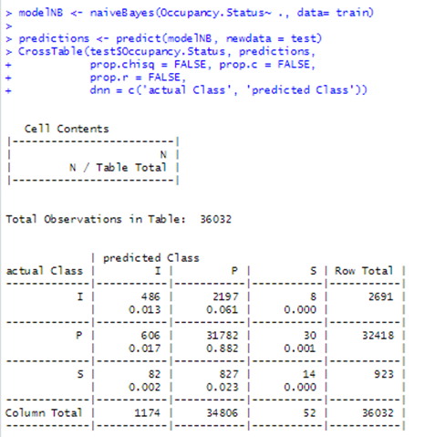
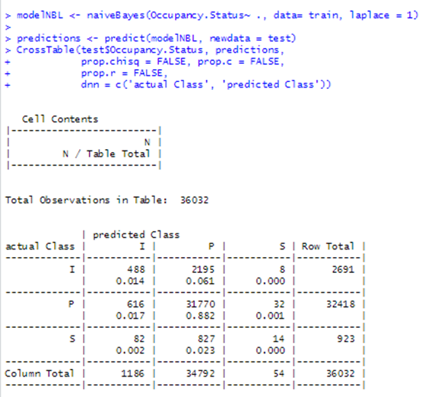
Naïve Bayes with and without Laplace Estimator

Slide 23
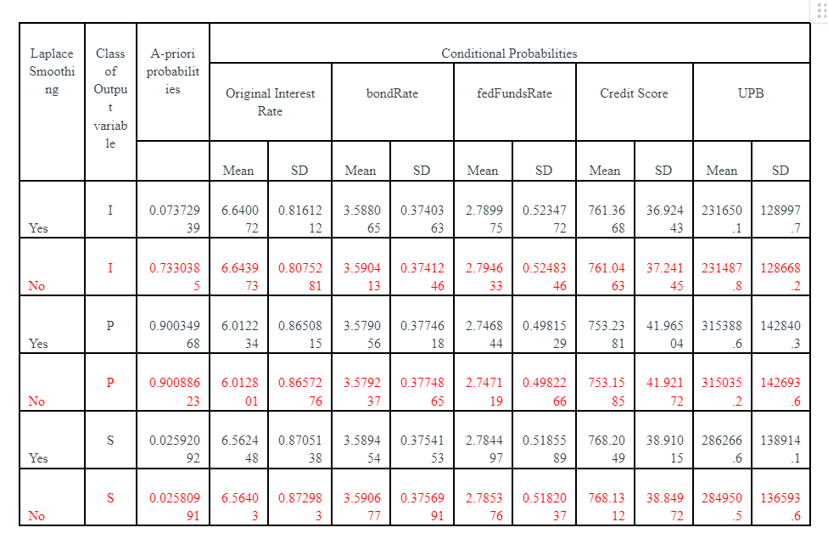
NB Model performance comparison
Logistic Regression: Good at predicting "P"; moderate for "I" and "S".
NB (without Laplace): Strong bias towards "P".
NB (with Laplace): Improved "P" predictions; "I" and "S" remain a challenge.
Key Insight: Correlated predictors (fedFundsRate, benchMarkMortgageRate) might be affecting NB's performance.
Most Predictive Features: Original Interest Rate, Bond Rate, and Federal Funds Rate.
Model Preference: Naive Bayes assumes independence between IVs. Hence is not a good fit for our dataset.
Recommendation: Further exploration with more diversified datasets or advanced techniques to improve "I" and "S" class predictions.

Slide 24
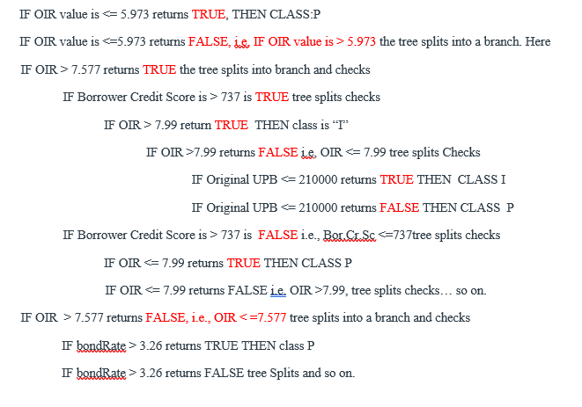
Phase 3: Decision Trees and Random Forests
Variables and Model Training : Chose the same Independent Variables (IVs) and Dependent Variable (DV) as used in previous Logistic Regression and Naïve Bayes analyses for consistency in Run1
Model Training with C5.0: Utilized the C5.0() function in R to train the Decision Tree.
If-Then Rules Interpretation: The Decision Tree structure can be explained using a series of IF-THEN rules.
Example Rule: IF "Original Interest Rate" is <= 5.973, THEN CLASS: P
Further splits occur based on other conditions, leading to a comprehensive tree structure.

Slide 25
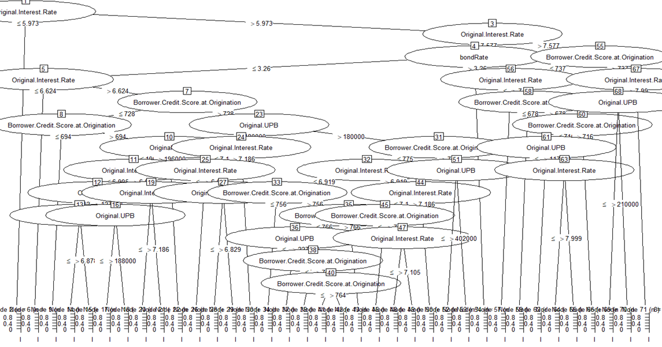
Training and Predicting
Decision Tree is a hierarchical structure of nodes that recursively partitions data into subsets until a stopping condition is met. Each leaf node represents a specific outcome of prediction.
The Internal Nodes in the decision tree represent conditions used to classify data. These are the ‘IF” part in the if-then rules.
The leaf nodes or terminal nodes represent the final outcomes, the ‘THEN’ part.
Notes:
Should i add

Slide 26
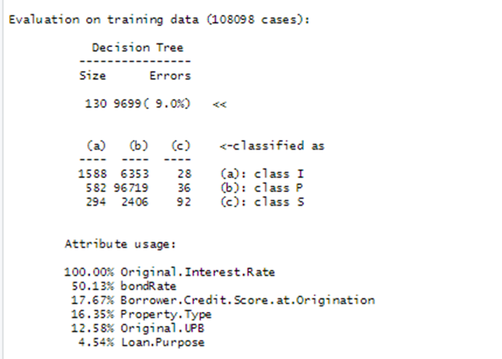
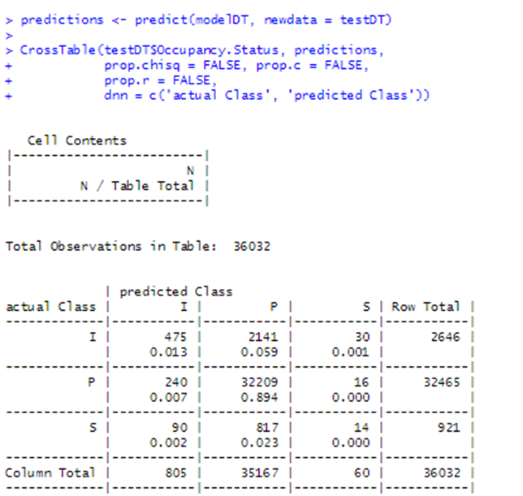

Slide 27
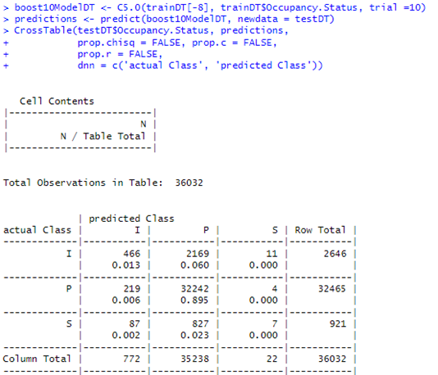
3.c : Boosting The Trees
Rationale Behind Boosting with Decision Trees:
Decision trees can sometimes have high variance and fit noise.
Boosting combines multiple weak learners (trees) to create a strong learner,reduces bias and variance, improving overall predictive power.
Trials Overview:
Various trials conducted with different numbers of trees: 10, 20, 50, and attempts with 100.
Goal: Determine the optimal number of trees for maximum accuracy.
Run-1
10 Trees: Initial improvements observed, especially for the 'P' class.
20 Trees: Further enhancements in predicting the 'P' class, slight deterioration for 'I'.
50 & 100 Trees: Maximum performance reached with 50 trees; no additional benefits observed with 100.
Run-2 : Boosting with 10 Trees did not improve results.
Insights on Model Performance:
Boosting improved accuracy, primarily for the dominant class 'P'.
Challenges persist for the 'S' class, even with boosting.
Boosting showed significant benefits up to 50 trees.
Diminishing returns observed beyond this point, indicating an optimal range around 50 trees for this dataset.

Slide 28
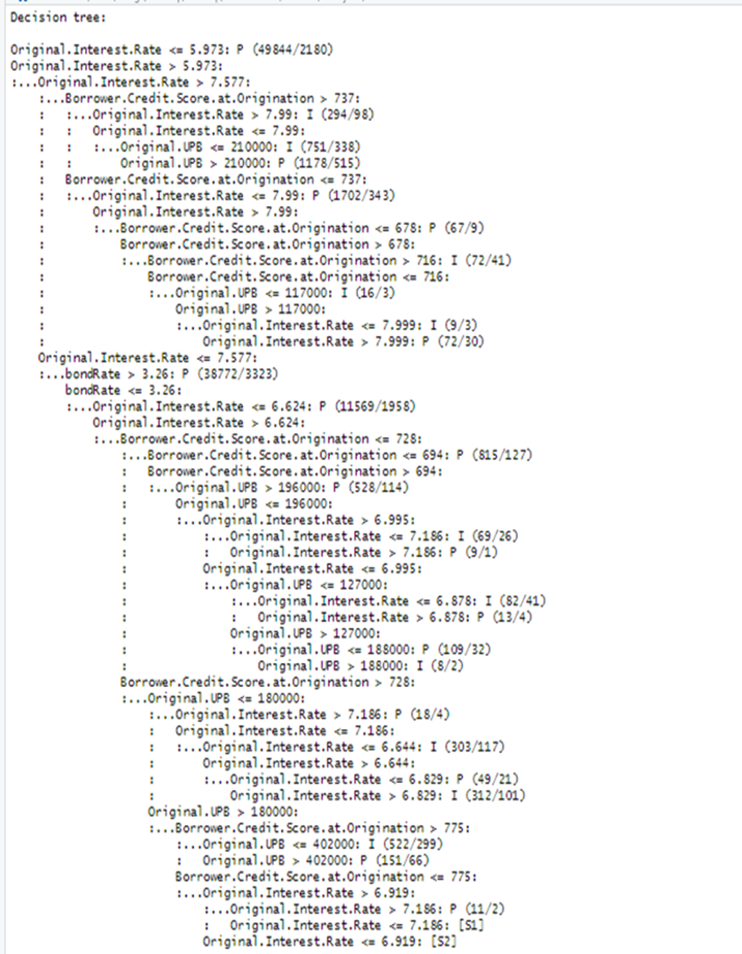
Reflecting on the Decision Tree and Boosting Analysis
Key Takeaways:
Dataset Distribution Significance: Ensuring similar distribution in training and testing datasets is vital for unbiased model evaluation.
Decision Trees' Value: Offer clear, interpretable results. Can capture intricate data relationships, but susceptible to noise.
Boosting's Role:
Enhances accuracy and reduces overfitting. But, selection of optimal number of trees is crucial: too few may not capture complexities, too many can overfit or add no value. This was evident from the results of our analysis for Run-2. In Run-1 with 4 IVs, we found significant improvement with Boosting. But with 2 additional IVs in Run-2 Boosting was not as effective.
In general, Boosting techniques in Decision Tree models show marked improvement in learning.

Slide 29
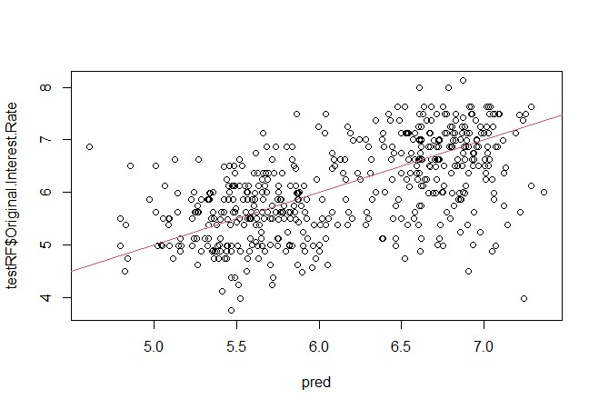
3.d Bagging {& Random forests}
Definition: Bagging vs. Random Forests.
Key challenge: Handling large datasets.
Importance: Ensemble methods for improving prediction accuracy.
Dataset Features and Sampling:
Breakdown of IVs: Run-1 bondRate, fedFundsRate, Borrower Credit Score, Original UPB. Run-2 all IVs
DV: Original Interest Rate.
Dataset size: 144,130 observations,
Challenge: Computation time & resource constraints.
Solution: Random sampling to 1,000 observations for practicality.
The Power of Bagging
Concept: Bootstrapping + Aggregating.
Objective: Reduce variance, not bias.
Model results with 500 trees: 0.57 correlation for Run-1 improved to 0.655 for Run-2.
Visual: Scatter plot of predicted vs. actual values.
Notes:
Please change the image to the one most appropriate here

Slide 30
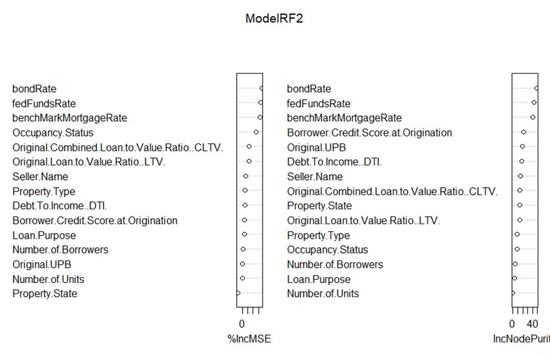
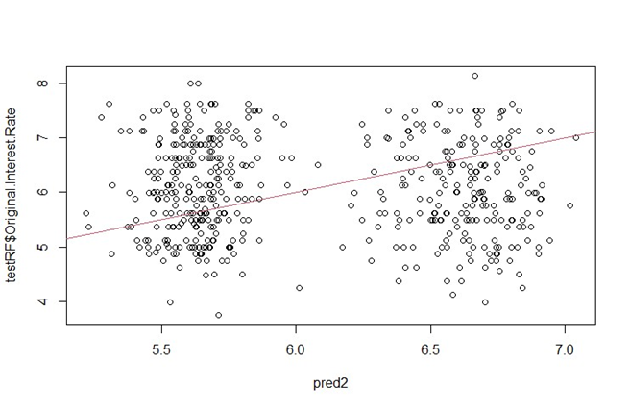
Random Forests
Basics: Use of multiple decision trees, subset of features.
Advantage: Lower variance, more robust model.
Correlation with bagging 0.655 with Random forest 0.677.
Visual: Distinct patterns in the predicted vs. actual value graph.
Importance of Variables in Random Forests
Explanation: How Random Forests evaluate feature importance.
Graphical representation: Importance of features understood by their ability to impact MSE and Node Purity.
Key takeaways: Dominance of fedFundsRate and bondRate in predictions.
Varying Trees for Deeper Insights
Procedure:Train different models with different tree counts .
Observations: Correlation 0.68, MSE 0.41 for 15 IVs Vs DV
Emphasis on consistent findings: bondRate as the top predictor followed by fedFundsRate
Visual: Predictions and actual plot of ModelRF2, the best performing model shows values more aligned with each other

Slide 31
SUMMARIZING RESULTS BAGGING VS. RANDOM FORESTS FOR ANALYSIS
NO OF TREES | BAGGING |  |  | RF |  |  | Improvement in Correlation in Random Forest Models from Bagging models | Most Preditive Features as per Random Forest Analysis(Imp Variables Plot) in Order of importance
 | No of Ivs | Cor | MSE | No of Ivs | Cor | MSE
100 | 4 | 0.5662334 | 0.5378488 | 2 | 0.6087091 | 0.4796896 | 0.0424757 | 1.fedFundsRate 2.bondRate 3. Original UPB 4. Borrower Credit Score
200 | 4 | 0.5719019 | 0.5303927 | 2 | 0.6061396 | 0.4833997 | 0.0342377 | same as above
300 | 4 | 0.5757962 | 0.5273337 | 2 | 0.60544383 | 0.4836421 | 0.02964763 | same as above

Slide 32
SUMMARIZING RESULTS BAGGING VS. RANDOM FORESTS FOR ANALYSIS
NO OF TREES | BAGGING |  |  | RF |  |  | Improvement in Correlation in Random Forest Models from Bagging models | Most Preditive Features as per Random Forest Analysis(Imp Variables Plot) in Order of importance
 | No of Ivs | Cor | MSE | No of Ivs | Cor | MSE
400 | 4 | 0.5738547 | 0.5296372 | 2 | 0.6091867 | 0.4803481 | 0.035332 | 1.bondRate 2.fedFundsRate 3. Borrower Credit Score 4. Original UPB
500 | 4 | 0.5707298 | 0.5312899 | 2 | 0.6100299 | 0.4796074 | 0.0393001 | same as above

Slide 33
Comparative analysis
Research question 1.) Can we accurately predict the ‘Interest Rate’ applied to a mortgage loan by a lending institution, using criterion such as the Quantum of loan, Loan-To-Value ratio, Debt-To-Income ratio, Loan Purpose, Number of Borrowers and Credit Score of the Borrower/s, using our dataset?
Assessing Predictive Quality Across Classifiers
Multivariate regression analysis:
Linear regression analysis:
Methodology: Combinations of IVs w/ the DV Original interest rate.
Findings: Best model trained with bondRate, fedFundsRate, Borrower Credit score, UPB, and Seller Name with an R-squared value of 0.7.
Significance: bondRate and fedFundsRate have the highest coefficient magnitudes.
Criteria: Quantum of loan, Loan-To-Value ratio, Debt-To-Income ratio, Loan Purpose, Number of Borrowers, Credit Score of the Borrower/s, etc.
Initial Analysis: Small coefficients, R-squared values, low correlation, and high MSE indicating limited predictive power.
Adjustments: Introduction of new variables like bondRate, fedFundsRate, challenges with multicollinearity.
Bagging and Random Forest Models analysis:
Random Forests are superior for this analysis due to their ability to handle multi-collinearity, categorical, and nominal variables and are therefore the choice of model for this analysis!
Differentiation: Bagging uses all IVs, Random Forest uses 2 for 'mtry'.
Key Findings: Random Forests provided better quality answers, especially regarding the significance of fedFundsRate and bondRate.
Run-2 Analysis: Best results with mtry=2 in Random Forests.

Slide 34
2. Do all the borrower criteria such as the Quantum of loan, Loan-To-Value ratio, Debt-To-Income ratio, Loan Purpose, Number of Borrowers and Credit Score of the Borrower/s have equal influence over ‘Interest Rate’? If not, which criteria have more effect on Interest Rate?
Multivariate regression analysis:
Linear regression analysis:
Methodology: Use combinations of IVs to ascertain their collective impact on 'Interest Rate'.
Findings: Combination of Variables from the new dataset have a better impact on the Interest Rate.
Emphasis: New variables, particularly bondRate, Federal Funds Rate, and benchMarkMortgageRate, demonstrate substantial predictive power when used with Credit Score and Loan quantum ( UPB)
Objective: Assess the influence of borrower criteria on 'Interest Rate'.
Findings: With original Fannie Mae dataset, UPB and Borrower credit score have a mild inverse effect on Interest Rate. Other variables exhibit a smaller positive impact.
Seller Name Variable: Notable for its magnitude of coefficients in the linear regression model, model suffers from low R-squared value.
Bagging and Random forests analysis:
Random Forests again emerged as the most effective, especially with their proficiency in managing multi-collinearity, categorical, and nominal variables. Thus, they are our recommended model choice for this analysis as well!
Differentiation: Bagging encompasses all IVs, while Random Forest uses a subset.
Key Outcomes: ModelRF2 highlighted bondRate as the top predictor for the outcome, trailed by fedFundsRate and benchMarkMortgageRate

Slide 35

3)Revised: Can we accurately predict the class of Occupancy Status in the Loan dataset, based on the IVs, Original interest rate, bondRate, fedFundsRate, Borrower Credit Score and Original UPB (from the revised dataset)?
Logistic regression analysis:
Naive Bayes Classifier:
Coefficient Insights: Leveraged log odds and odd ratios to interpret coefficients.
Key Predictors: Identified “Seller Name”, "Original Interest Rate", "bondRate", and "fedFundsRate" as pivotal. After Run-2
Model Evaluation: Utilized Confusion Matrix to learn model's predictive power.
Initial Results: Model better at predicting P class than "I" and "P" classes. Struggles with predicting the "S" class.
Run-2 Adjustments: Integrated all dataset variables, begins "S" class prediction, though still with accuracy concerns for "I" and "S" classes.
Strengths: Predominant class ‘P’ prediction is well done
Weakness: Struggles with class ‘I’ and ‘S’
Model Assumption: Assumes variable independence.
Dataset Impact: Strong correlations among variables affect model performance.
Laplace Estimator: Minimal impact, hints at dataset's density.
Run-2 Adjustments: More variables integrated, yet "S" class prediction remains a challenge.
In this analysis, Boosted Decision Trees excelled due to their adaptability, precision, and resilience against common data challenges like handling of various data types.While some models grapple with distinct class predictions, Decision Trees consistently stand out, making them the top recommendation for this study!
Decision trees with and without boosting:
Transparency: If-then rules provide clear decision-making insights.
Initial Limitation: Struggled to predict the "S" class in early runs.
Run-2 Improvements: Comprehensive variables set led to better class prediction.
Comparison: Outperformed Logistic and Naive Bayes models.
Boosting Impact: Enhanced model's predictive capabilities.

Slide 36
References
Code and insights were used from class Youtube videos for this analysis
Multinomial Logistic Regression | R Data Analysis Examples (ucla.edu)
User's guide to correlation coefficients - PMC (nih.gov)
https://www.macrotrends.net/2016/10-year-treasury-bond-rate-yield-chart
https://www.usinflationcalculator.com/inflation/historical-inflation-rates/
https://www.macrotrends.net/2604/30-year-fixed-mortgage-rate-chart
https://data.bls.gov/timeseries/LNS14000000
https://www.macrotrends.net/2015/fed-funds-rate-historical-chart

Slide 37

See you in Milestone 3!

